Slide 1


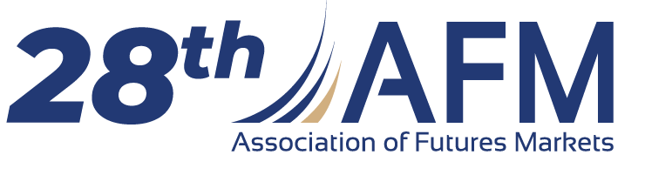
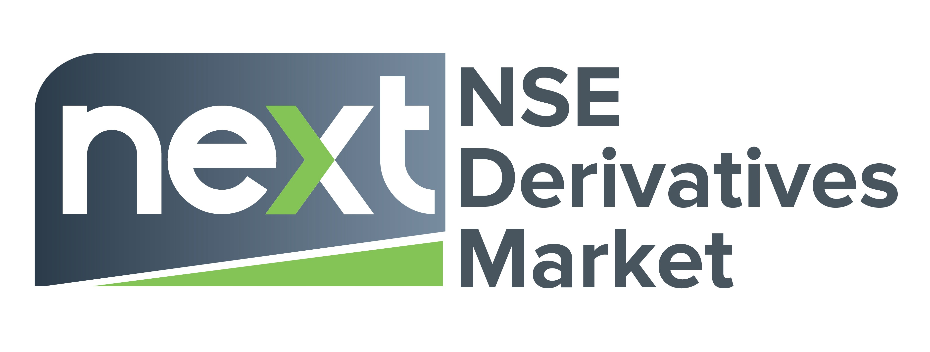

CASE STUDY
Activating Africa’s Retail
Derivatives Market
Nairobi Securities Exchange (NSE)
Trading, Data & Analytics Division
June 4–5, 2026 · Taipei, Taiwan

Slide 2






WHAT THIS SESSION COVERS
Key Focus
The starting point
A thinly traded futures market and a clear retail ambition.
Four deliberate reforms
Contract resizing, a bigger market-making fund, Zidii Trader, and Soko Play.
The impact, in the data
Turnover, contracts traded, daily activity and participation, 2024/5 vs 2026.
An honest read
What actually drove the numbers and what the next phase must prove.
28th AFM Annual Conference · Taipei 2026
2
Notes:
This slide lays out the argument in four moves: the starting point (what the market looked like before), the four reforms themselves, the impact visible in the data, and an honest read of what that data does and does not prove. The fourth item is included on purpose: the deck is not just a growth story, it explicitly separates correlation from proven cause, which is what makes the case credible to a market-regulator audience.

Slide 3
NSE NEXT THE BASELINE
Where we started: a market built, but not yet busy
NSE NEXT is the derivatives segment of the Nairobi Securities Exchange East Africa’s first exchange-traded futures market, listing single-stock futures on Kenya’s blue-chips and an equity index future.
KES 170M
6,683
2024 annual turnover
Contracts traded, 2024
Notional traded, full year
Across the whole year
Through 2024 the market worked pricing, clearing and settlement were sound but activity was thin and concentrated among a handful of institutional members. The contract was simply too big, and too hard to reach, for an ordinary Kenyan investor.
~491
~98%
Total investor accounts
Turnover from a few members
~92% individuals a small base
Liquidity highly concentrated
28th AFM Annual Conference · Taipei 2026
3
Notes:
The baseline - the "before" state. NSE NEXT is the derivatives segment of the Nairobi Securities Exchange and East Africa's first exchange-traded futures market, listing single-stock futures and an equity index future. The point of the slide is that by 2024 the market was technically sound - pricing, clearing and settlement all worked - but activity was thin and concentrated in a handful of institutional members. The four figures quantify that: KES 170M of turnover for the entire year, 13,366 contracts, roughly 491 accounts (mostly individuals, but a very small base), and about 98% of turnover coming from a few members. The underlying diagnosis is that the contract was too big and too hard to access for an ordinary Kenyan investor - which is what the four reforms were designed to fix.

Slide 4



Four reforms,
one goal: activate retail
Each one removed a different barrier between Kenyans and the futures market.
Notes:
Section divider introducing the reform package. The framing is that the four reforms were not random initiatives but a coordinated set, each removing a different barrier between retail investors and the futures market: the size of the contract, the depth of the market, the means of access, and the confidence to participate.

Slide 5


REFORM 1
Cutting contract sizes 10× to fit a retail wallet
Every standard contract was made ten times smaller. A position that once needed institutional capital now fits a retail budget.
The goal: to make it affordable for retail investors to access the market and diversify portfolio’s.
Most retail investors began trading with $100 but could only hold 1 or 2 contracts
BEFORE
AFTER
WHY IT MATTERS
Lower-priced stocks
1,000 shares / contract
Higher-priced stocks
100 shares / contract
Lower-priced stocks
100 shares / contract
Higher-priced stocks
10 shares / contract
~90% lower
capital to hold one contract.
The same notional now trades as 10 smaller contracts finer position sizing, and a price tag an ordinary investor can act on.
÷ 10
e.g. SCOM ≈ KES 25,000 notional per contract
e.g. SCOM ≈ KES 2,500 notional per contract
28th AFM Annual Conference · Taipei 2026
5
Notes:
Reform 1 - contract size. Standard contract sizes were reduced tenfold: lower-priced stocks moved from 1,000 to 100 shares per contract, and higher-priced stocks from 100 to 10. The worked example (Safaricom) shows the notional value of a single contract falling from about KES 25,000 to about KES 2,500 - roughly 90% less capital to hold one position. The "why it matters" point is that the same total notional now trades as ten smaller contracts, which lets retail investors size positions finely and brings the ticket price within reach. The figures are indicative at illustrative share prices, and the equity index future (N25I) was left unchanged.

Slide 6


REFORM 2
A larger market-making fund to build real depth
Smaller contracts only matter if there is someone to trade against. NSE expanded the capital behind its market-making programme so quotes stay on screen and retail orders fill.
Market-making programme turnover (KES millions)
~3×
48%
MM turnover, 2024→2026
Share from the MM book
KES 72M → ~KES 206M
Up from 42% in 2024
Designated market makers now underwrite the bulk of on-screen liquidity the depth that lets a retail order trade at a fair price, any day.
*2026 = Jan–Apr (partial year).
28th AFM Annual Conference · Taipei 2026
6
Notes:
Reform 2 - the market-making fund. A smaller contract only helps if there is someone to trade against, so NSE expanded the capital behind its market-making programme to keep firm quotes continuously on screen. The chart shows market-making-programme turnover roughly tripling, from about KES 72M in 2024 to about KES 206M in 2026 (a partial year), with the programme's share of turnover rising from 42% to 48%. The takeaway is that designated market makers now underwrite most on-screen liquidity - the depth a retail order needs to fill at a fair price. This is also the reason most turnover is currently market-maker-driven: depth was built first, by design. (The actual fund size, before and after, is not yet in the deck and would be the strongest single proof point.)

Slide 7

REFORM 3
Zidii Trader: putting the market in every pocket
Zidii Trader (“zidi” Swahili for “more / multiply”) is a mobile-first trading gateway. It replaces “open a bank account, then a broker account” with onboarding and funding straight from a phone via M-Pesa.
Friction Zidii Trader removes
WHAT IS M-PESA?
Launched by Safaricom in 2007, M-Pesa is Kenya’s mobile-money network enabling users to send, receive, pay and save from any phone, no bank account required.
It is used by the large majority of Kenyan adults and moves transaction value worth a very large share of the economy each year. For most Kenyans, M-Pesa not a bank is how money moves.
So the single biggest on-ramp to retail finance in Kenya is mobile money. Wire the futures market to M-Pesa, and the addressable retail base goes from thousands to millions.
From bank-account barrier
Fund and withdraw directly from M-Pesa instant, familiar, no paperwork queue.
From broker friction
Guided mobile onboarding compresses days of forms into minutes on a phone.
From “not for me”
A simple, retail-grade interface makes futures legible to a first-time investor.
28th AFM Annual Conference · Taipei 2026
7
Notes:
Reform 3 - Zidii Trader, with the M-Pesa context an international audience needs. M-Pesa, launched by Safaricom in 2007, is Kenya's mobile-money network: it lets people send, receive, pay and save from any phone with no bank account, it is used by the large majority of Kenyan adults, and it moves transaction value worth a very large share of the economy. For most Kenyans, money moves through M-Pesa rather than a bank - so the single largest on-ramp to retail finance in Kenya is mobile money. Zidii Trader is NSE NEXT's mobile-first gateway that connects the futures market to that on-ramp: it replaces the old "open a bank account, then a broker account" route with onboarding and funding straight from a phone. The right-hand column lists the specific frictions it removes - the bank-account barrier, broker paperwork, and the perception that futures are "not for me."

Slide 8




REFORM 4
Soko Play: turning curiosity into confidence
Soko Play (“soko” Swahili for “market”) is a gamified activation campaign anchored by the NSE Investment Challenge. New users learn derivatives through low-stakes, competitive play before risking real money, then graduate into live trading on Zidii Trader.
›
›
1. ATTRACT
2. TEACH
3. CONVERT
Social-led “Soko” content + a public investment challenge bring a wide audience in.
Simulated trading, leaderboards and prizes build skill and habit risk-free.
Confident players move to funded accounts and trade live.
A pipeline, not a poster: education feeds activation, and activation feeds the order book.
28th AFM Annual Conference · Taipei 2026
8
Notes:
Reform 4 - Soko Play. This is a gamified activation campaign, anchored by the NSE Investment Challenge, designed to convert curiosity into confident participation. The three stages explain the funnel: Attract (social content and a public challenge bring a wide audience in), Teach (simulated trading, leaderboards and prizes build skill and habit with no real-money risk), and Convert (confident players graduate to funded accounts on Zidii Trader). The idea is that education and activation are a single pipeline rather than separate marketing efforts.

Slide 9
The impact:
2024/5 → 2026
Following the reform package, every measure of activity stepped up sharply.
Notes:
Section divider introducing the impact section. It signals the shift from "what we did" to "what happened," and frames the next three slides: following the reform package, every measure of market activity stepped up sharply. The honest framing - growth shown first, then explained - is set up here.

Slide 10
IMPACT 1 OF 3
Turnover stepped up by an order of magnitude
Monthly derivatives turnover (KES millions, single-leg)
KES 448M
First 5 months of 2026
Already 2.6× all of 2024
~6×
Annualised 2026 vs 2024
~KES 1.1B run-rate vs 170M
Inflection from late-2025, as the reforms compounded.
28th AFM Annual Conference · Taipei 2026
10
Notes:
Impact 1 - turnover. The line chart compares monthly single-leg turnover across 2024, 2025 and 2026. The shape is the message: turnover was flat-to-low through 2024 and most of 2025, then inflected sharply from late 2025 as the reforms compounded. The stat cards quantify it: the first five months of 2026 (KES 448M) already exceed all of 2024 (KES 170M) by 2.6 times, and annualised that is roughly a KES 1.1B run-rate, about six times 2024. The language is deliberately "following the reforms" rather than "because of" - this is a correlation in time, not a controlled experiment.

Slide 11
IMPACT 2 OF 3
More, smaller contracts the retail footprint widens
Contracts traded per month
16×
Contracts in 5 months of 2026
vs all of 2024 (218,900 vs 13,366)
Peak month: 2,532 contracts (Mar 2024) → 80,500 (Feb 2026).
28th AFM Annual Conference · Taipei 2026
11
Notes:
Impact 2 - participation. Contracts traded per month is the cleaner proxy for retail footprint, because the contracts are now smaller, so more of them trade for the same notional. The 2026 bars dwarf prior years: 218,900 contracts in five months versus 13,366 in all of 2024, about sixteen times, and the peak month rose from 2,532 contracts (March 2024) to 80,500 (February 2026). On accounts, the claim is deliberately measured: new accounts grew 44% (from 63 to 91) and 2026 is on a similar pace, but from a small base - so the strong evidence is in the contract-count and turnover, not in account numbers.

Slide 12
IMPACT 3 OF 3
A deeper, busier market still safely covered
Who provides the turnover (2026)
~31×
9–14×
Average daily turnover
Guarantee-fund cover
KES 224K (Jan-24) → 7.0M (Feb-26)
Still comfortably covers daily risk
The honest read
The surge is liquidity-provider led: market makers supply almost all turnover today. That is by design depth comes first. Retail accounts and direct retail volume are growing from a small base; converting that depth into a broad retail order book is the work of the next phase.
28th AFM Annual Conference · Taipei 2026
12
Notes:
Impact 3 - market structure, and the honest read. The doughnut shows that about 99% of 2026 turnover comes from market makers, with direct retail and other-member volume still around 1%. Average daily turnover is up about 31 times (from KES 224K to KES 7.0M), and the settlement guarantee fund still covers daily risk comfortably (9-14 times), so the growth has not come at the expense of safety. The honest read states plainly that the surge is liquidity-provider-led by design - depth comes first - and that retail accounts and direct retail volume are still growing from a small base. Converting that depth into a broad retail order book is explicitly named as the work of the next phase, rather than claimed as already achieved.

Slide 13


LESSONS
What made it work and what comes next
Sequence the reforms
Meet retail where it is
Educate before you activate
Be honest about the base
Shrink the ticket, then guarantee the liquidity to fill it. Order mattered.
In Kenya that means mobile money. M-Pesa is the on-ramp, not a nice-to-have.
Soko Play builds confidence first; funded trading follows.
Depth is here; broad retail conversion is the next milestone to prove.
Reform the product, fund the liquidity, ride the rails people already use then convert.
28th AFM Annual Conference · Taipei 2026
13
Notes:
Lessons - the synthesis. Four generalisable takeaways: sequence the reforms (shrink the ticket first, then fund the liquidity to fill it); meet retail where it already is (in Kenya that means mobile money, so M-Pesa is the on-ramp rather than an optional add-on); educate before you activate (Soko Play builds confidence before funded trading); and be honest about the base (depth is in place, but broad retail conversion is the next milestone, not a finished result). The banner condenses the whole argument: reform the product, fund the liquidity, ride the rails people already use - then convert.

Slide 14
Asante.
Thank you questions welcome.
Nairobi Securities Exchange · NSE NEXT
Trading, Data & Analytics Division
28th AFM Annual Conference · Taipei, June 2026
Notes:
Closing slide. It thanks the audience and invites questions. By design it leaves the deck on a candid footing rather than a triumphant one: the growth is real and safe, but it is currently market-maker-led, and two pieces of evidence remain open - the actual size of the market-making fund before and after, and concrete Zidii Trader and Soko Play activation metrics. Those are the natural questions an informed audience will ask, and the deck's honesty about them is intended as a strength.

