Slide 1
Excellence built through resilience, innovation and trust.
Lessons from JSE: Revenue diversification through non-trading business
Johannesburg Stock Exchange (JSE)
June 2026

Slide 2
Key Focus
Revenue diversification an imperative
How JSE achieved a truly diversified exchange business
What measurable results were achieved
Lessons from JSE journey

Slide 3
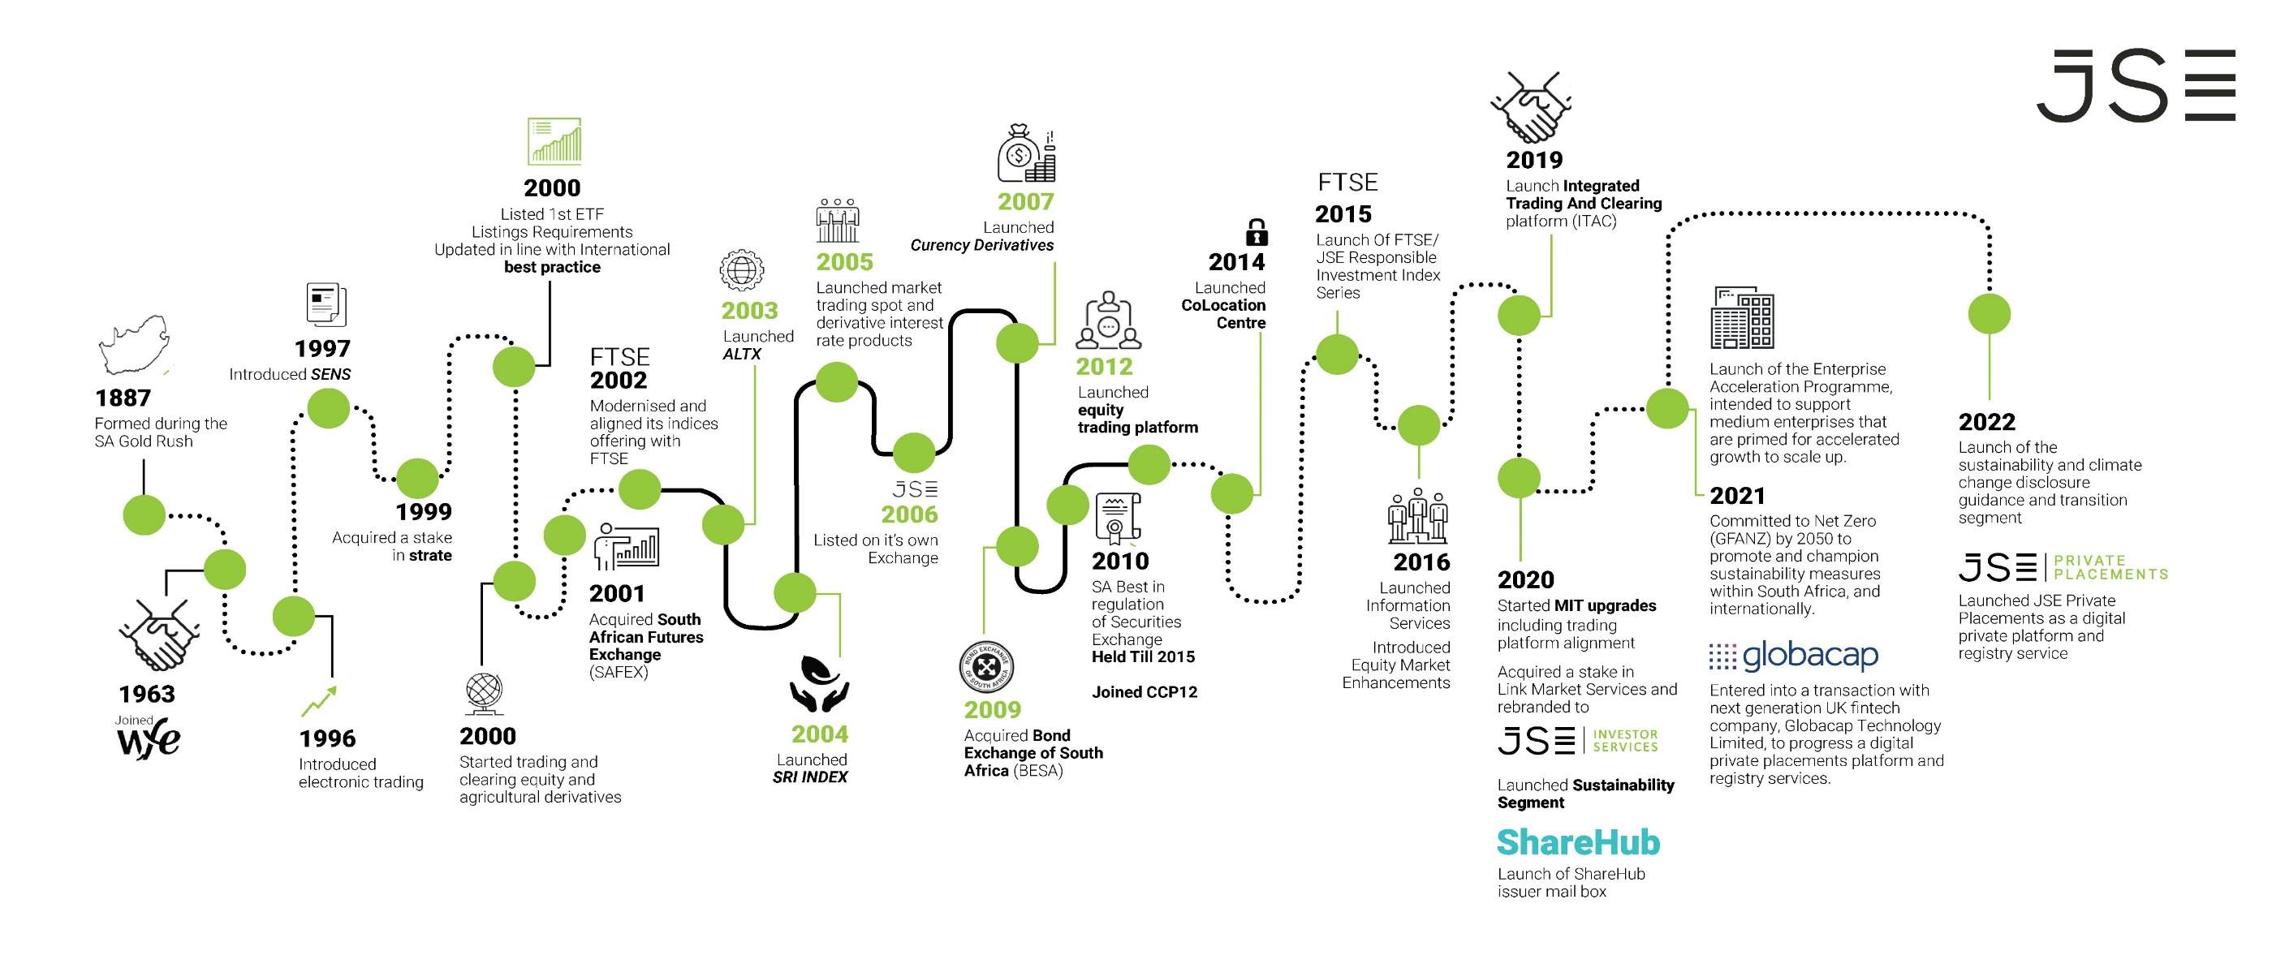

Slide 4
Revenue Diversification an Imperative

Slide 5
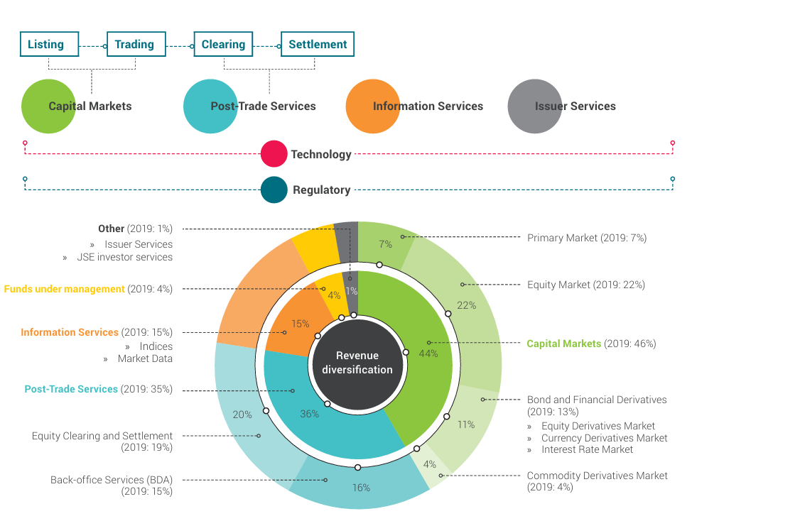
Revenue Composition 2020
Creation of value for shareholders
Cyclical income vs annuity income
Equity Marker largest contributor macro economic exposure
Protecting the core by delivery of innovative solution

Slide 6
Truly Diversified Exchange
INNOVATION|ACQUISITION|PARTNERSHIP

Slide 7
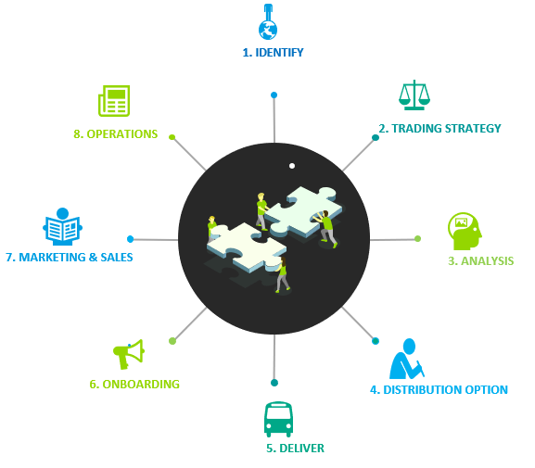
Innovation through extended services
Market data sales aims to diversify revenue through data analytics services, and data distribution.
Colocation, along with associated services and products is aims to diversify revenue, while improving the JSE’s value proposition and ensuring global competitiveness
JSE FIX Hub
Tech Provider Platform
Bespoke +
DR Solution
Colo Initiatives
Automated Billing
Connectivity Strategy
Client Acquisition
AWS Cloud
Geographical Expansion + Africa

Slide 8
JSE INVESTOR SERVICES
Registry
Comprehensive listed and unlisted share registry, meetings services as well as multi-channel investor communications
Custodial Services
JSE Investor Services (Pty) Limited will hold your shares and funds in safe custody.
Diversifying revenue through acquisition
Shareholder Management
Share ownership analysis, market intelligence, investor communication and shareholder management technology
Stakeholder Engagement
Comprehensive advisory, execution and proxy solicitation services

Slide 9
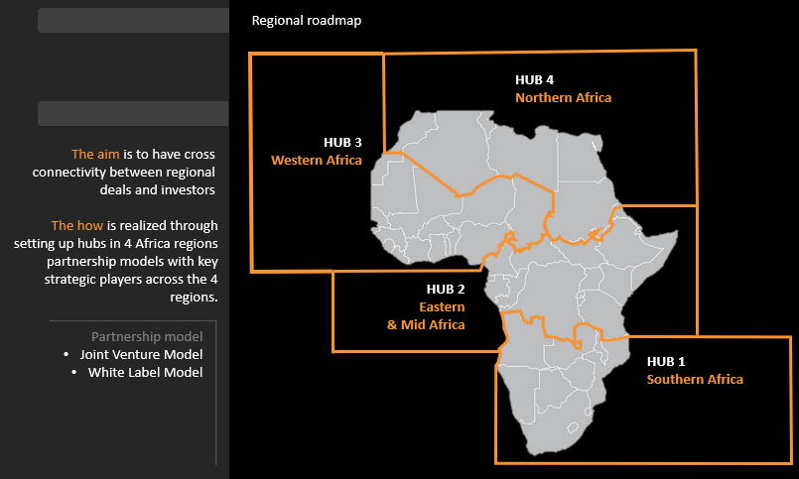



JSE PRIVATE PLACEMENTS
JSE Private Placements (JPP) is an online platform that assists SMEs and Infrastructure projects to raise debt and/or equity from pre-qualified investors.
Our Vision
Be the leading private markets platform in Africa
Our Mission
To accelerate Africa’s growth by facilitating capital formation and liquidity in private markets
Our Strategy
To expand JPP’s growth and distribution through strategic partnerships within our eco-system. We will focus on advisors, banks and African exchanges to attain continental reach. Furthermore, we will build an international network with Globacap.

Slide 10
What measurable results were achieved

Slide 11
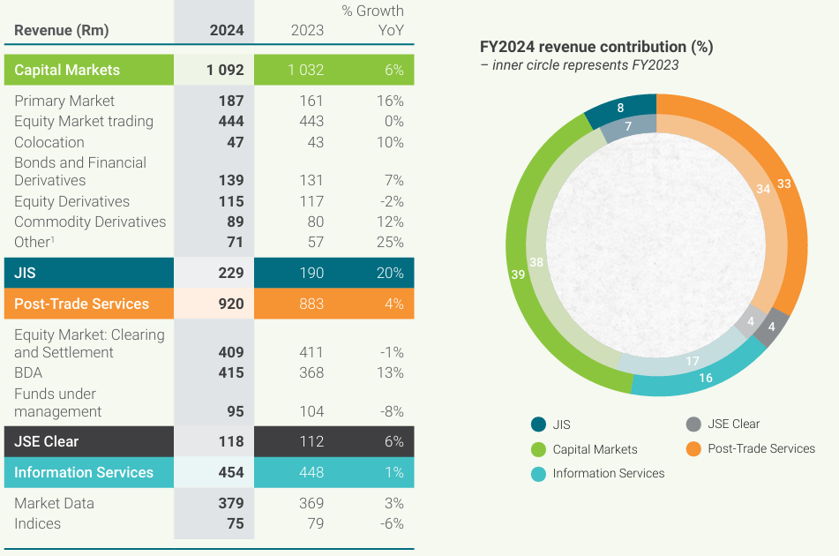
Diversified Revenue
Truly diversified exchange

Slide 12
Lessons from JSE journey

Slide 13
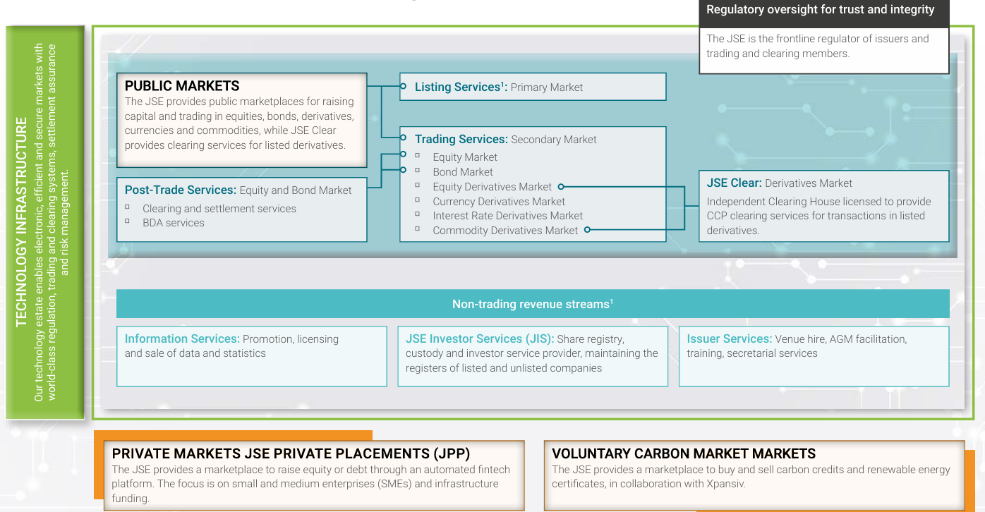
Implications of Diversification
New business initiative extractive in initial stages
Capacity spread too thin
Prioritization paramount
Identity

Slide 14
Navigating challenges
How does JSE navigate the challenges as we imagine the exchange of the future.
CASE STUDY: MTS JSE Bond market
South Africa’s electronic government bonds trading platform
Serves as the primary Electronic Trading Platform (ETP).
Fully managed trading services

Slide 15
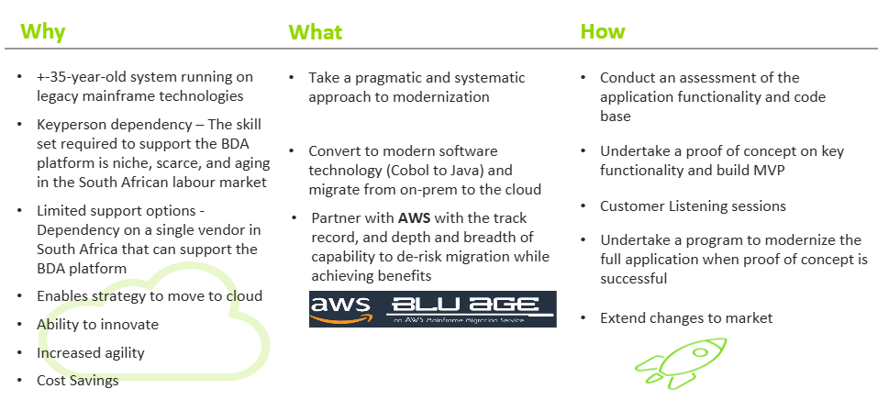
Navigating challenges
How does JSE navigate the challenges as we imagine the exchange of the future.
CASE STUDY: BDA MODERNISATION

Slide 16
Thank you

